Slide 1
Internet Surveillance
George Corser
February 5, 2015

Slide 2
Agenda
What is Internet surveillance?
Why do we need Internet surveillance?
Why control Internet surveillance?
What are search warrants?
When are warrants “warranted”?
Stingrays – warrantless wiretapping
Metadata and gmail – secret warrants
Storage of surveillance data – information collected from searches, warrant or no
FISA and EO 12333 – easy warrants
Google, Microsoft, Twitter
Closing Questions (not closing answers!)

Slide 3
What is Internet Surveillance?
Surveillance
to watch over – paying close attention to personal details for the purpose of influencing, managing or controlling those under inspection or scrutiny (Lyon)
Purposeful, routine, systematic, focused attention paid to personal details for the sake of control, entitlement, management, influence or protection (OIC report 2006)
Internet surveillance
Communications Assistance For Law Enforcement Act, mandates that all phone calls and broadband internet traffic (emails, web traffic, instant messaging, etc.) be available for unimpeded, real-time monitoring by Federal law enforcement agencies (Wikipedia)
Surveillance is not the same as censorship (but monitoring may change behavior)

Slide 4
Why Internet Surveillance?
Prevent future attacks
9/11 attack: 2996 dead, 2977 injured
Enacted USA Patriot Act of 2001
Justifies government authorities’ internet surveillance
Would NSA surveillance have stopped 9/11?
No: CNN, 2013
Maybe: CBS News, 2013
Threats
Terrorism, war (direct attacks, comms)
Child pornography
Stalking, bullying, harassment
Drugs (esp: Silk Road), money laundering
Identity theft/fraud (esp: credit cards)
Intellectual property/piracy (esp: music)
Pranking, overreach (Washington Post, 2013): Andrew Auernheimer, Matthew Keys, Aaron Swartz

Slide 5
Why Control Internet Surveillance?
Governmental checks and balances
If angels were to govern men, neither external nor internal controls on government would be necessary. James Madison (The Federalist No. 51, 1788)
Most anything used for a good purpose can also be used for a bad purpose. Most anything controlled by good guys can be commandeered (or hacked) and used by bad guys.
If surveillance is not dangerous, should citizens monitor government officials? (If citizens can monitor law enforcement, so can crooks.)
People v. Melongo (AP, 2014): For recording a phone call Melongo spent 2 years in jail and then case was dismissed
Boston police resist being monitored by GPS tracking devices (Boston Globe, 2013)

Slide 6
What are Search Warrants?
A search warrant is an order signed by a judge that authorizes police officers to search for specific objects or materials at a definite location. For example, a warrant may authorize the search of "the single-dwelling premises at 11359 Happy Glade Avenue” and direct the police to search for and seize "cash, betting slips, record books, and every other means used in connection with placing bets on horses.“ (Nolo)
Over the years, courts have defined a number of situations in which a search warrant isn't necessary, either because the search is reasonable under the circumstances or because, due to a lack of a reasonable expectation of privacy, the Fourth Amendment doesn't apply at all. (Nolo)

Slide 7
When are Warrants “Warranted”?
Stingrays – warrantless wiretapping
Metadata and gmail – secret warrants
Storage of surveillance data – information collected from searches, warrant or no
FISA and EO 12333 – easy warrants

Slide 8
Stingrays

Slide 9
Stingrays can be used to intercept and monitor calls.
Image source: http://warrantless.org/2014/09/pd-hack/#more-1713

Slide 10
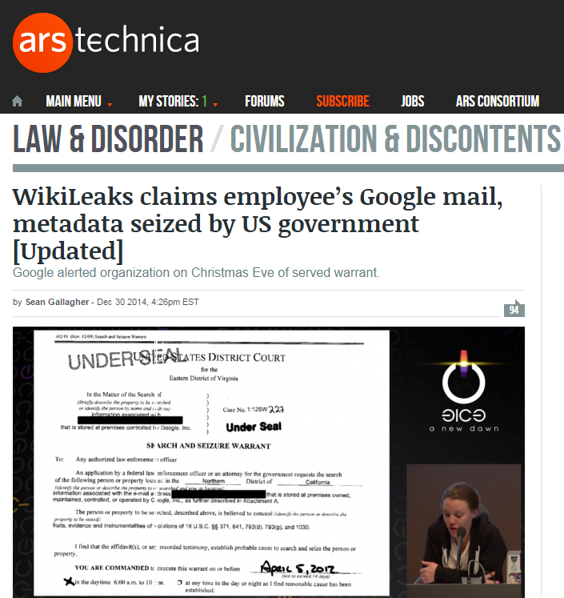
Metadata and Gmail

Slide 11
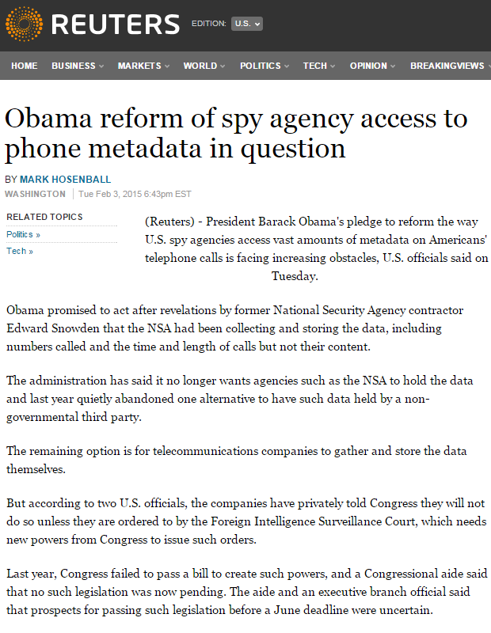
Storage of Surveillance Data
Obama administration does not want NSA to control the data
Two options have been forwarded, a third party or Telcos (may need FISA authorization)

Slide 12
FISA and EO 12333
The Foreign Intelligence Surveillance Act of 1978 is a United States federal law which prescribes procedures for the physical and electronic surveillance and collection of "foreign intelligence information" between "foreign powers" and "agents of foreign powers" (which may include American citizens and permanent residents suspected of espionage or terrorism).
Executive Order 12333 has been regarded by the American intelligence community as a fundamental document authorizing the expansion of data collection activities. NSA used it as legal authorization for its secret systematic collection of unencrypted information flowing through the data centers of internet communications giants Google and Yahoo.

Slide 13
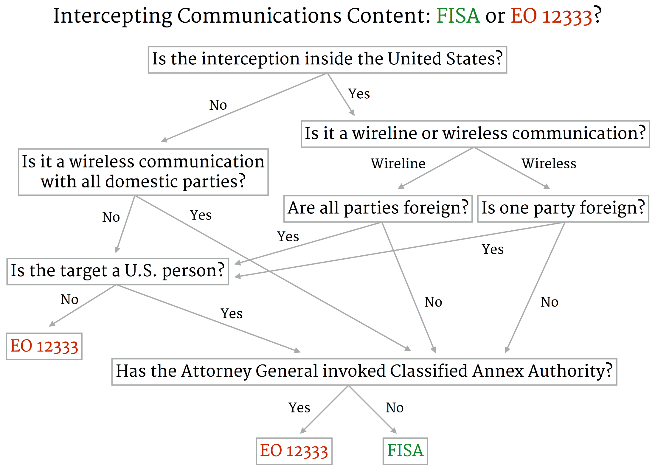
Source: http://webpolicy.org/2014/12/03/eo-12333-on-american-soil/

Slide 14
What is the FISA Court?
The court is housed in a room in a windowless and secure area of the U.S. District Court on Constitution Avenue. Government sources say it's a courtroom with a judge's bench, tables for lawyers, and support staff. Officials won't divulge its exact location in the building.
The court is made up of 11 judges who sit for seven-year terms. All are federal district judges who agree to take on the additional duties on a rotating basis. They are appointed by Chief Justice John Roberts, without any supplemental confirmation from the other two branches of government. Roberts has named every member of the current court, as well as a separate three-judge panel to hear appeals known as the Court of Review.
Source: http://www.cnn.com/2014/01/17/politics/surveillance-court/

Slide 15
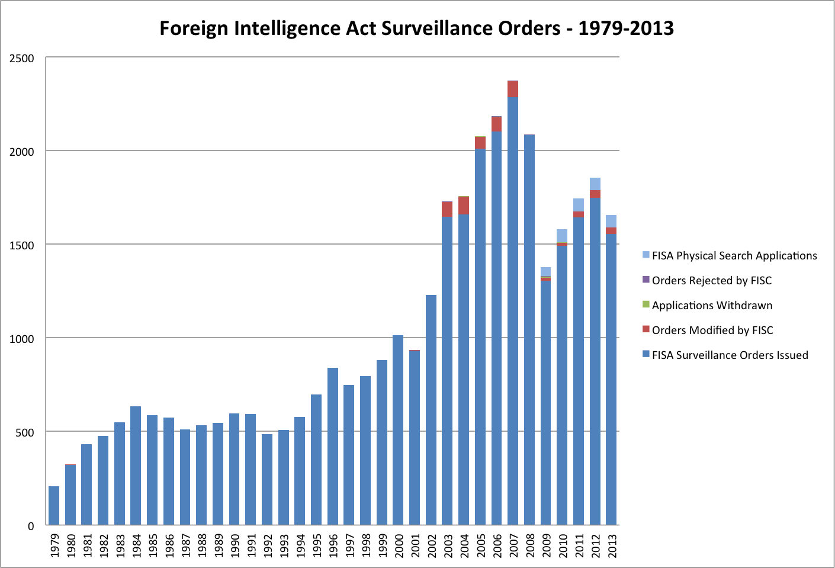

Slide 16
Google, Microsoft, Twitter
Collectively, Google, Facebook, Microsoft, and Twitter report receiving tens of thousands of requests for user data from the US government annually.
In 2012, Google received more than 16,400 requests covering 31,000-plus user accounts from federal, state, and local authorities.
In 2013 Google asked permission to publish info about FISA requests
http://www.npr.org/blogs/thetwo-way/2013/06/11/190723995/google-asks-permission-to-publish-info-about-fisa-requests
Above chart includes ALL requests, not just FISA.
Source: http://www.motherjones.com/politics/2013/06/google-microsoft-twitter-facebook-user-data-fisa-charts

Slide 17
Google Transparency Report
Source: http://www.google.com/transparencyreport/

Slide 18
Google Transparency Report
Source: http://www.google.com/transparencyreport/

Slide 19
Crossing Lines from Citizen to Spy
Report a crime
Collect data for cops
Stasi
Quarter soldiers
Forced automated data collection

Slide 20
Closing Questions
How do we maximize defenses against threats while minimizing overreach or other abuse by the authorities we empower?
Should law enforcement use laws to advance their own positions, against criminals, and against citizens or policymakers who attempt to limit their powers?
Should businesses be forced to perform (and pay for) surveillance and maintain the recordkeeping?

